Slide 1
Powell Up
By Team 404

Slide 2
Statement of Purpose
Our purpose it to make a make a game that incorporates fortune telling so that it is replayable and unpredictable.
It’ll be a fun, engaging, and insightful way to explore our curiosity about the future and ourselves.
It's a lighthearted way to explore our curiosity about the future and can be a source of amusement for both the fortune teller and the person receiving the prediction.
This will serve as a form of stress relief or relaxation. The act of playing the game and receiving a funny prediction can be a welcome distraction from the stresses of everyday life.
It will serve as a great way for people to socialize and interact with each other. They can be used as icebreakers or as a way to get to know new people.

Slide 3
General Overview
Roguelike game using fortune telling to generate buffs/debuffs/items for the player
Random encounters are essentially mini games against random “opponents” like an exam, issue with project, Powell himself, etc.
Exact format TBD (pokemon esque choices, interactive minigame, etc.)
Player’s choices and ability to complete these counters are based off the fortune telling prior to the random encounter
The game starts at the beginning of CSE 110 and the encounters progress to the end of CSE 110, where Powell would be the final “boss”
Based on the player’s decisions, fortunes, and outcomes of the random encounters, the game will generate a fortune for the student’s grade in the class and give predicted reasons for that grade (e.g. reference a bug in code if the player failed a random encounter about trying to fix a bug)

Slide 4
User Personas - Elon
Elon Musk, the CEO of Tesla.
Elon often cannot solve problems and end up being stuck and need a break. When Elon is unable to solve problems he boots up this application to relax and laugh at the funny future the game predicts. He is very stressed out with all of his work, and always likes to have a laugh by playing games.

Slide 5
User Personas - Kevin Nguyen
Kevin, 21, Third-year college student
Kevin worked four hours on Real Analysis homework, but has only solved a third of the homework problems. Kevin feels very fatigued and unmotivated to continue working, so he decides to take break by playing and asks the game about life’s biggest questions.

Slide 6
User Personas - Jack
Jack, 18, High School Student
Jack is a high school student who enjoys playing video games in his free time. He likes games that offer a lot of action and excitement, with fast-paced gameplay and challenging levels. He enjoys games that offer customization options, such as character creation or the ability to customize weapons and equipment. He was appealed by the user interface and would like to try the (fortune teller program).

Slide 7
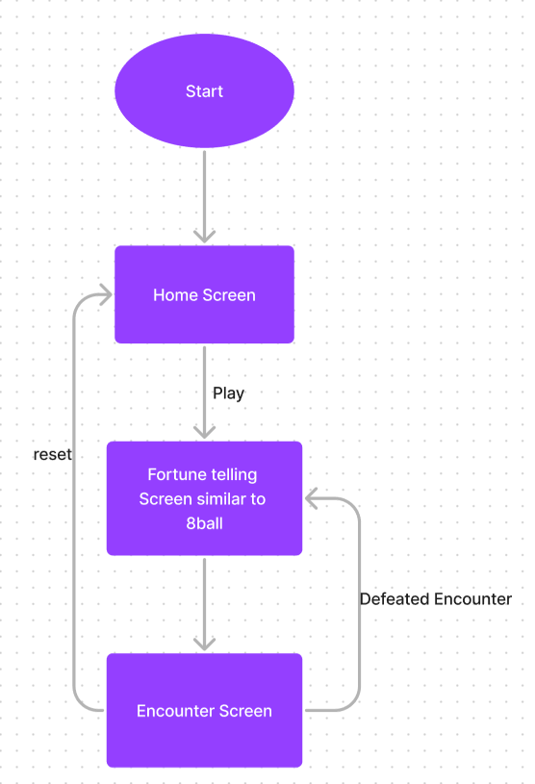
Flow Chart

Slide 8
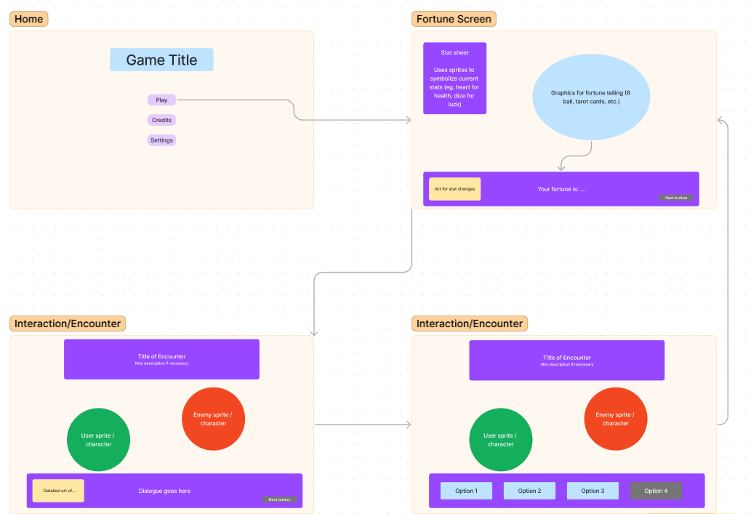
Wireframes

Slide 9
Risks/Rabbit Holes
There are a lot of different encounters that we can do, so it can be very difficult making all of them and integrating them well
Adding graphics alongside player statistics when they get a fortune can be difficult as well
There will be a lot of animations that need to be made
A rabbit hole we could fall into is focusing too much on creating a solid framework for the game

